Slide 1
Adaptive Goal Management
MVP website: https://adaptive-goal-management.herokuapp.com/
Github: https://github.com/mukmalone/AdpativeGoalManagement
By Michael Muldoon
michael.muldoon.home@gmail.com

Slide 2
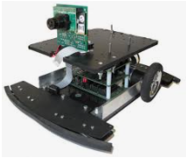
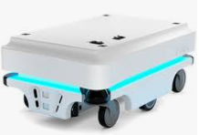
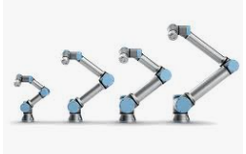
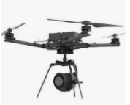
What is it?
An adaptive goal execution system
Designed for robotics and drones connected to the Internet

Slide 3
What does it do?
Dynamically manages a series of steps or goals for a robot to perform

Slide 4
How does it work?
Let’s use an example in a manufacturing context

Slide 5
Definitions
First some language, everything is built around aerospace manufacturing terminology and practices:
Worker = your robot/drone
Workstation = target source or destination location where something happens
Routing = A set of manufacturing steps needed to complete a product or activity
Customer = Who is this work being performed for
Part number = A defined combination of a customer and routing which will deployed
As you get creative you can think of ways to deploy this in every setting.

Slide 6
Communication
Worker talks to AGM through API using HTTP

Slide 7

What you need to accomplish
First_Product
Station_1
Station_2
Station_3
Station_4
Station_5
Make this
Infeed Buffer
Outfeed Buffer

Slide 8

Another thing you need to accomplish
Second_Product
Station_1
Station_2
Station_3
Station_4
Station_5
Make this
Infeed Buffer
Outfeed Buffer

Slide 9

A third thing to accomplish
Fast_Product
Station_1
Station_2
Station_3
Station_4
Station_5
Make this
Infeed Buffer
Outfeed Buffer

Slide 10
Setting it up
Station_1
Station_2
Station_3
Station_4
Station_5
Worker: Tesla
Workstations
Routings
name: First_Product
Steps:
Station_1
Station_2
Station_3
Station_4
Station_5
Outfeed Buffer
name: Second_Product
Steps:
Station_5
Station_4
Station_3
Station_2
Station_1
Outfeed Buffer
name: Fast_Product
Steps:
Station_4
Station_2
Outfeed Buffer
Infeed Buffer
Outfeed Buffer
Workstations

Slide 11
Setting it up cont’d
Customer
Routing
Part Number
name: First_Product
Steps:
Station_1
Station_2
Station_3
Station_4
Station_5
Outfeed Buffer
First_Product
First_Customer
name: Fast_Product
Steps:
Station_4
Station_2
Outfeed Buffer
Second_Product
name: Second_Product
Steps:
Station_5
Station_4
Station_3
Station_2
Station_1
Outfeed Buffer
Second_Customer
Fast_Product

Slide 12
Setting things in motion
Activate
Assign
Fast_Product
PO identifier PO1
Serial Number SN1
First_Product
PO identifier PO2
Serial Number SN2
Worker asks for job, AGM calculates optimal goal and assigns
Outfeed Buffer
First_Product
PO identifier PO3
Serial Number SN3
Fast_Product
PO identifier PO4
Serial Number SN4
Infeed Buffer
Second_Product
PO identifier PO5
Serial Number SN5
Fast_Product
PO identifier PO6
Serial Number SN6

Slide 13
How a worker knows what to do
1.
2.
3.
4.
NEXTJOB
ACTIVATEJOB
MOVEWORKER
source
TAKEPART
Job Queue
po: PO1
Source: Infeed Buffer 1
Destination: Station 1
Step #: 0
PO in Station: empty
Job Active
po: PO1
Source: Infeed Buffer 1
Destination: Station 1
Step #: 0
PO in Station: empty
Job Active
po: PO1
Source: Infeed Buffer 1
Destination: Station 1
Step #: 0
PO in Station: PO1
Worker: Tesla
Infeed Buffer
5.
6.
7.
MOVEWORKER
Destination
LOADPART
ARCHIVEJOB
Start over
Job Active
po: PO1
Source: Infeed Buffer 1
Destination: Station 1
Step #: 0
PO in Station: empty
Job Queue
po:
Source: Destination:
Step #:
PO in Station: empty
Station_1

Slide 14
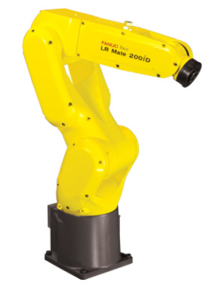
Example 2: Mixing multiple robots & jobs
Worker: Robot_Assemble
Worker: Robo_Inspect
workerGroup: Assembly
workerGroup: Inspection
Infeed Buffer
Assembly
Inspection
Outfeed Buffer
Worker: Robo_Mover
workerGroup: PO Movement

Slide 15
Questions/want to test/want to contribute
MVP website: https://adaptive-goal-management.herokuapp.com/
Github: https://github.com/mukmalone/AdpativeGoalManagement
By Michael Muldoon
michael.muldoon.home@gmail.com

